Slide 1
SESSIONS 17 AND 18
PERFORMANCE MANAGEMENT AND APPRAISALS

Slide 2
Basic Concepts in Performance
Management and Appraisal
Performance Appraisal
Performance Management
Setting work standards, assessing performance, and providing feedback to employees to motivate, correct, and continue their performance.
An integrated approach to ensuring that an employee’s performance supports and contributes to the organization’s strategic aims.
Copyright © 2011 Pearson Education, Inc. publishing as Prentice Hall
9–<number>
Notes:
Human Resources Management 12e
Gary Dessler
Copyright © 2011 Pearson Education, Inc. publishing as Prentice Hall
9–<number>
Every manager needs some way to appraise employees’ performance. If employees’ performance is good, you’ll want to reinforce it, and if it’s bad, you’ll want to take corrective action.
Performance appraisal means evaluating an employee’s current and/or past performance relative to his or her performance standards.

Slide 3
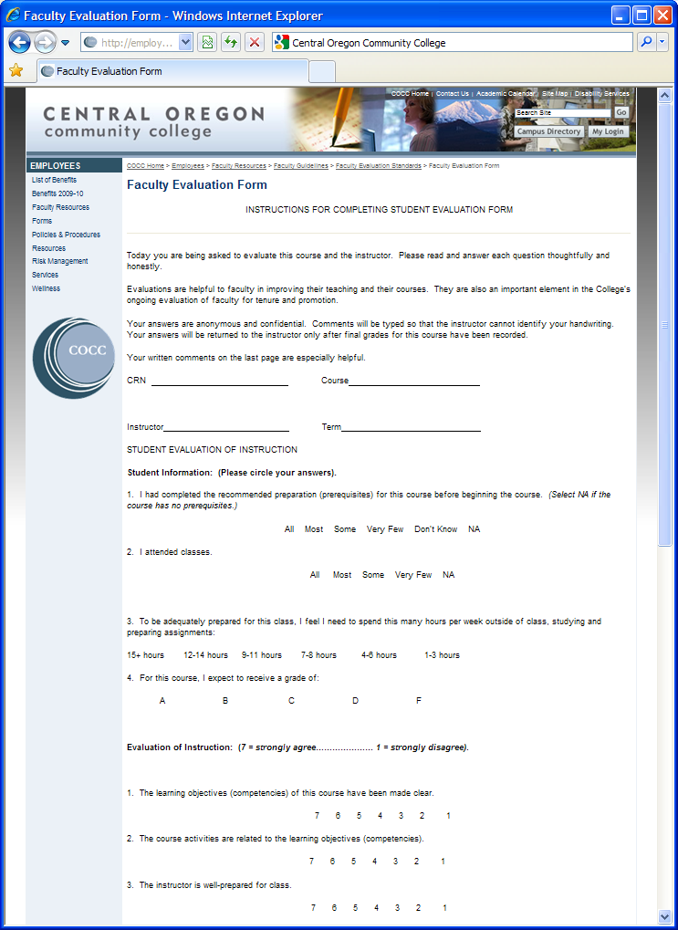
FIGURE 9–1
Online Faculty
Evaluation Form
Copyright © 2011 Pearson Education, Inc. publishing as Prentice Hall
9–<number>
Notes:
Human Resources Management 12e
Gary Dessler
Copyright © 2011 Pearson Education, Inc. publishing as Prentice Hall
9–<number>
For most people, “performance appraisal” brings to mind appraisal tools like the appraisal form in Figure 9-1, but appraisal is more than forms.

Slide 4
Defining the Employee’s Goals and Work Standards
Guidelines for Effective
Goal Setting
Set
SMART
goals
Assign specific
goals
Assign measurable goals
Assign challenging/ doable goals
Encourage participation
Copyright © 2011 Pearson Education, Inc. publishing as Prentice Hall
9–<number>
Notes:
Human Resources Management 12e
Gary Dessler
Copyright © 2011 Pearson Education, Inc. publishing as Prentice Hall
9–<number>
Managers should appraise employees based on previously assigned criteria (goals and standards) that they are expected to achieve, such as “add 10 new customers next year.”

Slide 5
Setting SMART Goals
Specific, and clearly state the desired results.
Measurable in answering “how much.”
Attainable, and not too tough or too easy.
Relevant to what’s to be achieved.
Timely in reflecting deadlines and milestones.
Copyright © 2011 Pearson Education, Inc. publishing as Prentice Hall
9–<number>
Notes:
Human Resources Management 12e
Gary Dessler
Copyright © 2011 Pearson Education, Inc. publishing as Prentice Hall
9–<number>
Setting SMART goals assures that a performance appraisal is based on useful, specific, and effective goals.

Slide 6
An Introduction to Appraising Performance
Why Appraise Performance?
1
Is basis for pay and promotion decisions.
2
Plays an integral role in performance management.
3
Helps in correcting deficiencies and reinforcing good performance.
4
Is useful in career planning.
Copyright © 2011 Pearson Education, Inc. publishing as Prentice Hall
9–<number>
Notes:
Human Resources Management 12e
Gary Dessler
Copyright © 2011 Pearson Education, Inc. publishing as Prentice Hall
9–<number>
Appraisals have several purposes that relate both to the appraised employee and the organization.

Slide 7
(Un)Realistic Appraisals
Motivations for Soft Appraisals
  The fear of having to hire and train someone new.
  The unpleasant reaction of the appraisee.
  An appraisal process that’s not conducive to candor.
Hazards of Soft Appraisals
  Employee loses the chance to improve before being discharged or forced to change jobs.
  Lawsuits arising from dismissals involving inaccurate performance appraisals.
Copyright © 2011 Pearson Education, Inc. publishing as Prentice Hall
9–<number>
Notes:
Human Resources Management 12e
Gary Dessler
Copyright © 2011 Pearson Education, Inc. publishing as Prentice Hall
9–<number>
It doesn’t matter which tool you use if you’re less than candid when your subordinate is underperforming. A supervisor who rates an employee too high is doing a disservice to them and to the company. There’s nothing crueler than telling someone who’s doing a mediocre job that he or she is doing well.

Slide 8

Performance Appraisal Roles
The Supervisor’s Role
  Usually do the actual appraising
  Must be familiar with basic appraisal techniques
  Must understand and avoid problems that can cripple appraisals
  Must know how to conduct appraisals fairly
Copyright © 2011 Pearson Education, Inc. publishing as Prentice Hall
9–<number>
Notes:
Human Resources Management 12e
Gary Dessler
Copyright © 2011 Pearson Education, Inc. publishing as Prentice Hall
9–<number>
Supervisors must therefore be familiar with appraisal techniques, understand and avoid problems that can cripple appraisals, and know how to conduct appraisals fairly.

Slide 9

Performance Appraisal Roles (cont’d)
The HR Department’s Role
  Serves a policy-making and advisory role.
  Provides advice and assistance regarding the appraisal tool to use.
  Trains supervisors to improve their appraisal skills.
  Monitors the appraisal system effectiveness and compliance with EEO laws.
Copyright © 2011 Pearson Education, Inc. publishing as Prentice Hall
9–<number>
Notes:
Human Resources Management 12e
Gary Dessler
Copyright © 2011 Pearson Education, Inc. publishing as Prentice Hall
9–<number>
The human resources department serves a policy-making and advisory role. The human resource team should also be responsible for training supervisors to improve their appraisal skills, for monitoring the appraisal system’s effectiveness, and for ensuring that it complies with EEO laws.

Slide 10

Effectively Appraising Performance
Steps in Appraising Performance
1
Defining the job and performance criteria
2
Appraising performance
3
Providing feedback session
Copyright © 2011 Pearson Education, Inc. publishing as Prentice Hall
9–<number>
Notes:
Human Resources Management 12e
Gary Dessler
Copyright © 2011 Pearson Education, Inc. publishing as Prentice Hall
9–<number>
Effective appraisals should follow these three steps.

Slide 11

Designing the Appraisal Tool
What to Measure?
  Work output (quality and quantity)
  Personal competencies
  Goal (objective) achievement
How to Measure?
  Generic dimensions
  Actual job duties
  Behavioral competencies
Copyright © 2011 Pearson Education, Inc. publishing as Prentice Hall
9–<number>
Notes:
Human Resources Management 12e
Gary Dessler
Copyright © 2011 Pearson Education, Inc. publishing as Prentice Hall
9–<number>
The manager generally conducts the actual appraisal using a predetermined and formal tool like one or more of those described next. The two basic questions in designing the actual appraisal tool are what to measure and how to measure it.

Slide 12
Performance Appraisal Methods
Appraisal Methodologies
1
Graphic rating scale
6
Narrative forms
2
Alternation ranking
7
Behaviorally anchored rating scales (BARS)
3
Paired comparison
8
Management by objectives (MBO)
4
Forced distribution
9
Computerized and Web-based performance appraisal
5
Critical incident
10
Merged methods
Copyright © 2011 Pearson Education, Inc. publishing as Prentice Hall
9–<number>
Notes:
Human Resources Management 12e
Gary Dessler
Copyright © 2011 Pearson Education, Inc. publishing as Prentice Hall
9–<number>
Appraising performance requires choosing an appraisal tool, form, or methodology that provides an effective means for comparing a subordinate’s actual performance to the standards for his or her job.

Slide 13
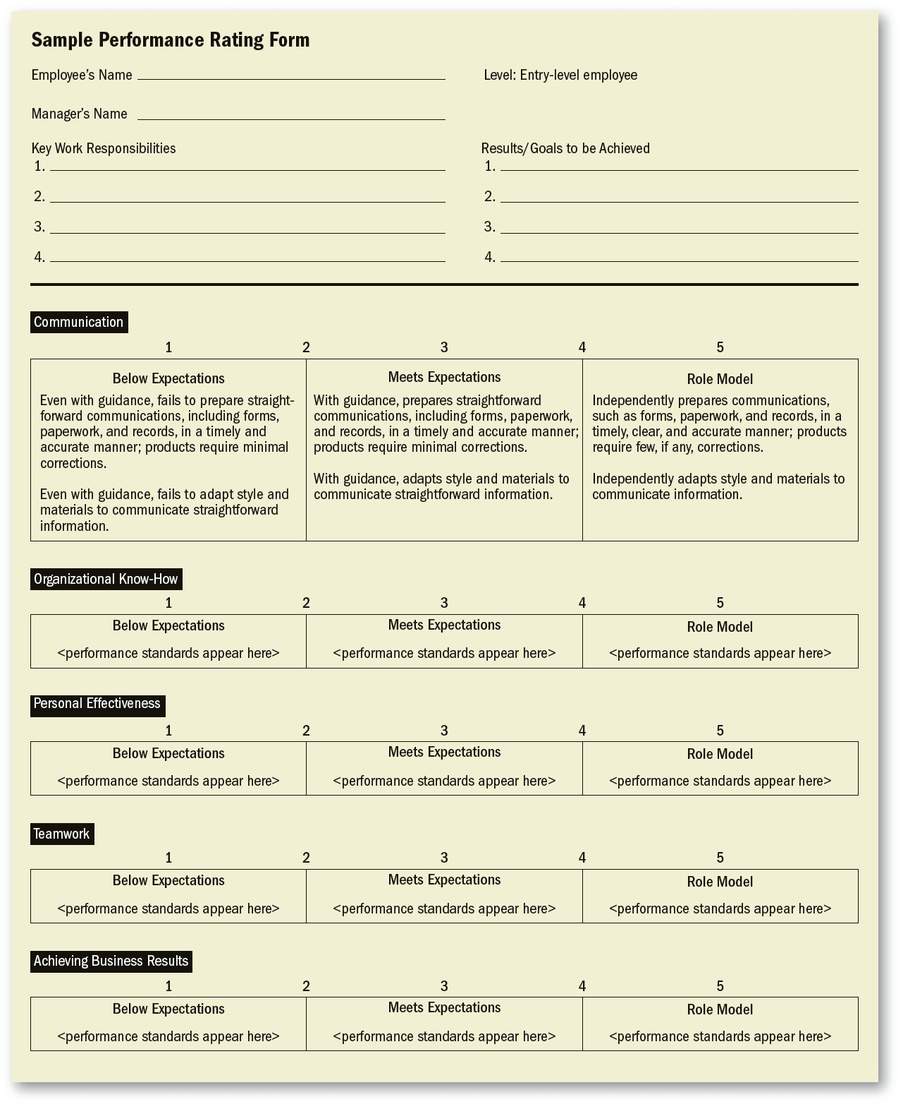
FIGURE 9–2
Sample Graphic
Rating Performance
Rating Form
Copyright © 2011 Pearson Education, Inc. publishing as Prentice Hall
9–<number>
Notes:
Human Resources Management 12e
Gary Dessler
Copyright © 2011 Pearson Education, Inc. publishing as Prentice Hall
9–<number>
Figure 9-2 shows one graphic rating scale. A graphic rating scale lists traits (such as “quality and reliability” or “teamwork”) and a range of performance values (from “unsatisfactory” to “outstanding,” or “below expectations” to “role model”) for each trait.

Slide 14
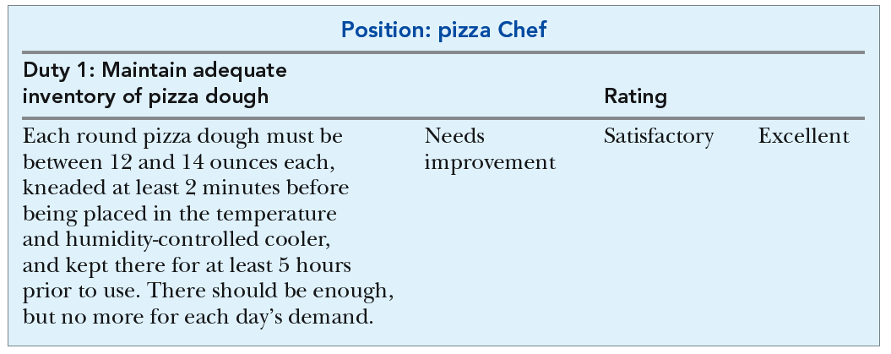
FIGURE 9–3 One Item from an Appraisal Form Assessing Employee Performance on Specific Job-Related Duties
Copyright © 2011 Pearson Education, Inc. publishing as Prentice Hall
9–<number>
Notes:
Human Resources Management 12e
Gary Dessler
Copyright © 2011 Pearson Education, Inc. publishing as Prentice Hall
9–<number>
Figure 9-3 shows part of an appraisal form for a pizza chef. This form assesses the job’s main sets of job-specific duties, one of which is “Maintain adequate inventory of pizza dough.” Here you would assess how well the employee did in exercising each of these duties.

Slide 15
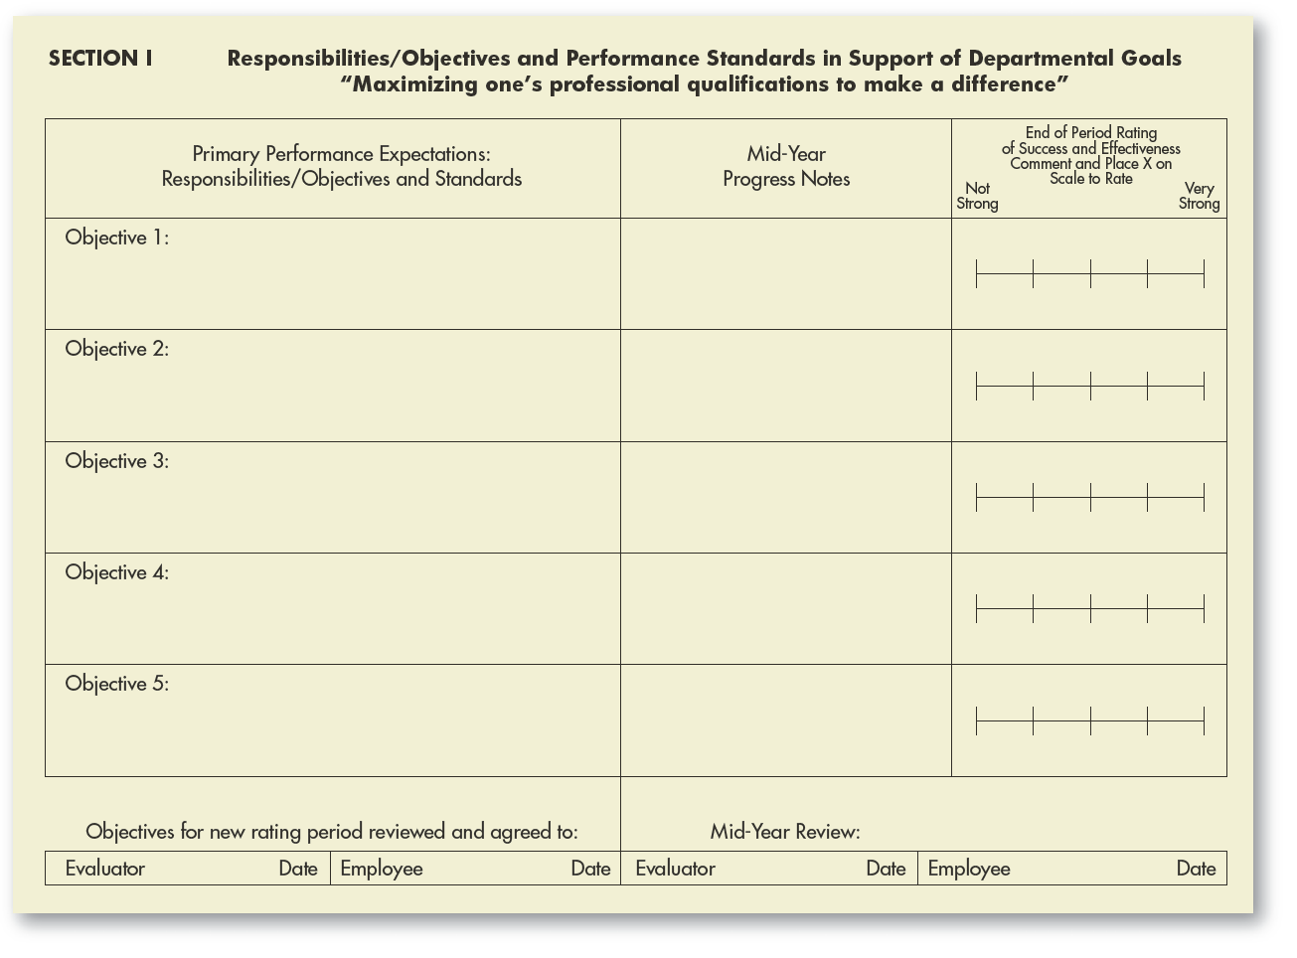
FIGURE 9–4 Appraisal Form for Assessing Both Competencies and Specific Objectives
Copyright © 2011 Pearson Education, Inc. publishing as Prentice Hall
9–<number>
Notes:
Human Resources Management 12e
Gary Dessler
Copyright © 2011 Pearson Education, Inc. publishing as Prentice Hall
9–<number>
Some graphic rating forms assess several things. Figure 9-4 (Section I) assesses the employee’s performance relating to both competencies and objectives. The employee and supervisor would fill in the objectives section at the start of the year, and then assess results and set new ones as part of the next appraisal.

Slide 16
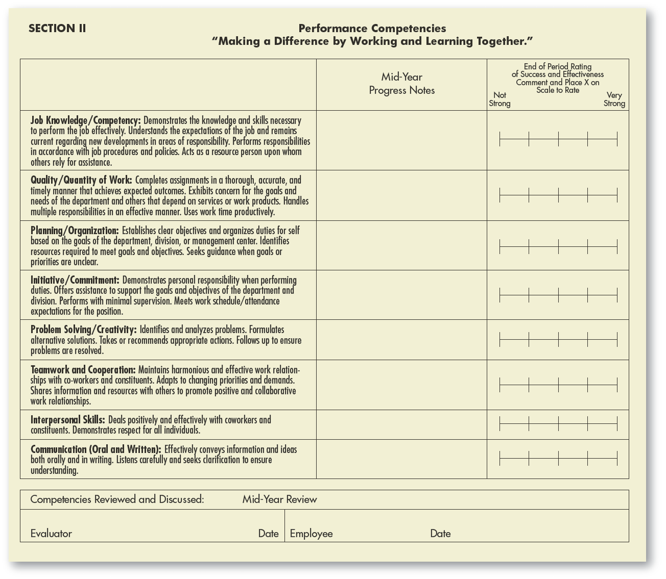
FIGURE 9–4 Appraisal Form for Assessing Both Competencies and Specific Objectives (cont’d)
Copyright © 2011 Pearson Education, Inc. publishing as Prentice Hall
9–<number>
Notes:
Human Resources Management 12e
Gary Dessler
Copyright © 2011 Pearson Education, Inc. publishing as Prentice Hall
9–<number>
Some graphic rating forms assess several things. In Figure 9-4, Section II illustrates the competencies an employee is expected to develop and exhibit such as “identifies and analyzes problems” (Problem Solving), and “maintains harmonious and effective work relationships with co-workers and constituents” (Teamwork).

Slide 17
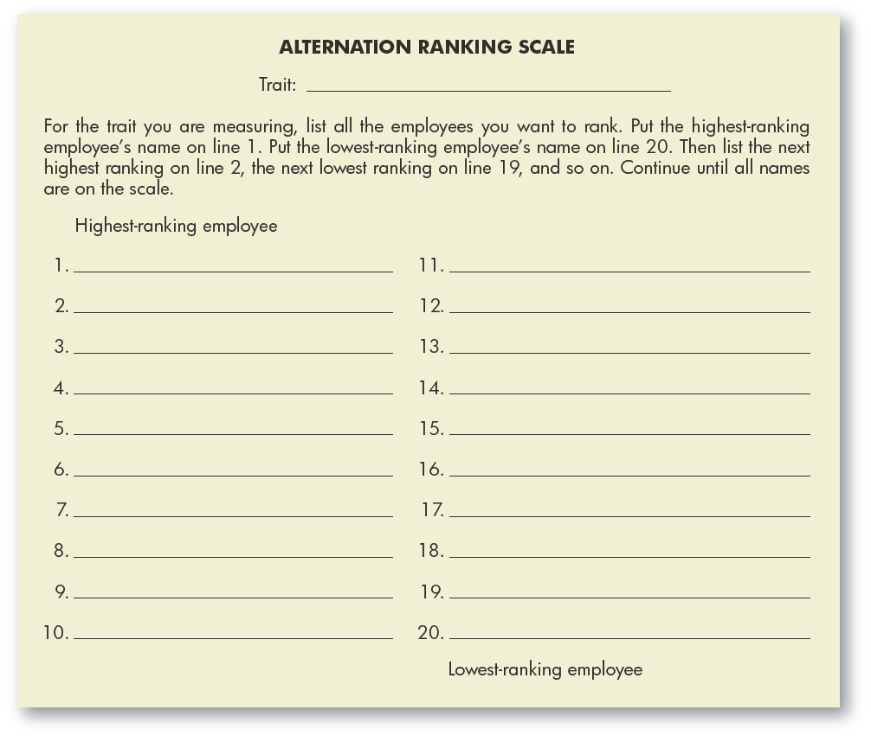
FIGURE 9–5 Scale for Alternate Ranking of Appraisee
Copyright © 2011 Pearson Education, Inc. publishing as Prentice Hall
9–<number>
Notes:
Human Resources Management 12e
Gary Dessler
Copyright © 2011 Pearson Education, Inc. publishing as Prentice Hall
9–<number>
Ranking employees from best to worst on a trait or traits is another option. Supervisors choosing the alternation ranking method would use a form like that in Figure 9-5 to alternately choose and list employees who are the highest on the characteristic being measured and the ones who are the lowest.

Slide 18
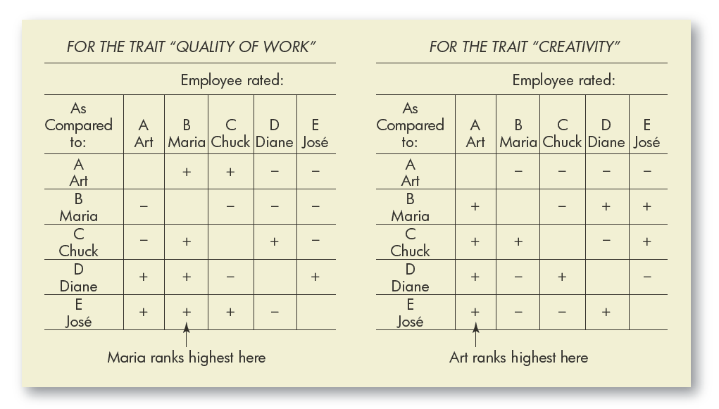
FIGURE 9–6 Ranking Employees by the Paired Comparison Method
Note: + means “better than.” - means “worse than.” For each chart, add up the number of +’s in each column to get the highest ranked employee.
Copyright © 2011 Pearson Education, Inc. publishing as Prentice Hall
9–<number>
Notes:
Human Resources Management 12e
Gary Dessler
Copyright © 2011 Pearson Education, Inc. publishing as Prentice Hall
9–<number>
The paired comparison method helps make the ranking method more precise. For every trait (quantity of work, quality of work, and so on), you pair and compare every subordinate with every other subordinate. In the paired comparison method, you make a chart, as in Figure 9-6, of all possible pairs of employees for each trait.

Slide 19

TABLE 9–1 Examples of Critical Incidents for Assistant Plant Manager
Continuing Duties | Targets | Critical Incidents
Schedule production for plant | 90% utilization of personnel and machinery in plant; orders delivered on time | Instituted new production scheduling system; decreased late orders by 10% last month; increased machine utilization in plant by 20% last month
Supervise procurement of raw materials and on inventory control | Minimize inventory costs while keeping adequate supplies on hand | Let inventory storage costs rise 15% last month; over-ordered parts “A” and “B” by 20%; under-ordered part “C” by 30%
Supervise machinery maintenance | No shutdowns due to faulty machinery | Instituted new preventative maintenance system for plant; prevented a machine breakdown by discovering faulty part
Copyright © 2011 Pearson Education, Inc. publishing as Prentice Hall
9–<number>
Notes:
Human Resources Management 12e
Gary Dessler
Copyright © 2011 Pearson Education, Inc. publishing as Prentice Hall
9–<number>
With the critical incident method, the supervisor keeps a log of positive and negative examples (critical incidents) of a subordinate’s work-related behavior. Every 6 months or so, supervisor and subordinate meet to discuss the latter’s performance, using the incidents as examples.
In Table 9-1, one of the assistant plant manager’s continuing duties was to supervise procurement and to minimize inventory costs. The critical incident log shows that the assistant plant manager let inventory storage costs rise 15%; this provides an example of what performance she must improve in the future.

Slide 20
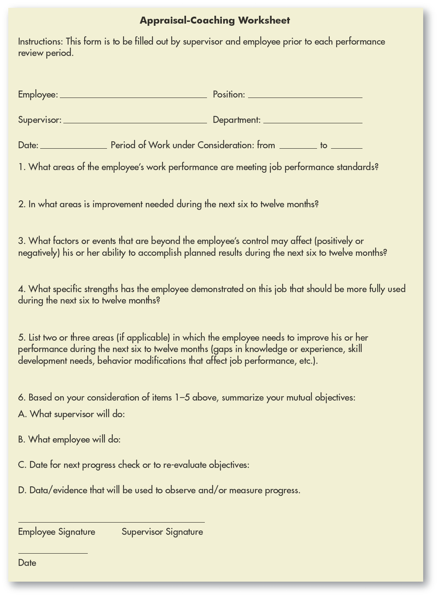
FIGURE 9–7
Appraisal-Coaching
Worksheet
Copyright © 2011 Pearson Education, Inc. publishing as Prentice Hall
9–<number>
Notes:
Human Resources Management 12e
Gary Dessler
Copyright © 2011 Pearson Education, Inc. publishing as Prentice Hall
9–<number>
All or part of the written appraisal may be in narrative form as shown in Figure 9-7. The supervisor’s narrative assessment aids the employee in understanding where his or her performance was good or bad, and how to improve that performance.

Slide 21
Behaviorally Anchored Rating Scale (BARS)
Developing a BARS
  Write critical incidents
  Develop performance dimensions
  Reallocate incidents
  Scale the incidents
  Develop a final instrument
Advantages of BARS
  A more accurate gauge
  Clearer standards
  Feedback
  Independent dimensions
  Consistency
Copyright © 2011 Pearson Education, Inc. publishing as Prentice Hall
9–<number>
Notes:
Human Resources Management 12e
Gary Dessler
Copyright © 2011 Pearson Education, Inc. publishing as Prentice Hall
9–<number>
A behaviorally anchored rating scale (BARS) is an appraisal tool that anchors a numerical rating scale with specific examples of good or poor performance. Its proponents say it provides better, more equitable appraisals than do the other appraisal tools. It takes more time to develop a BARS, but the tool has several advantages.

Slide 22
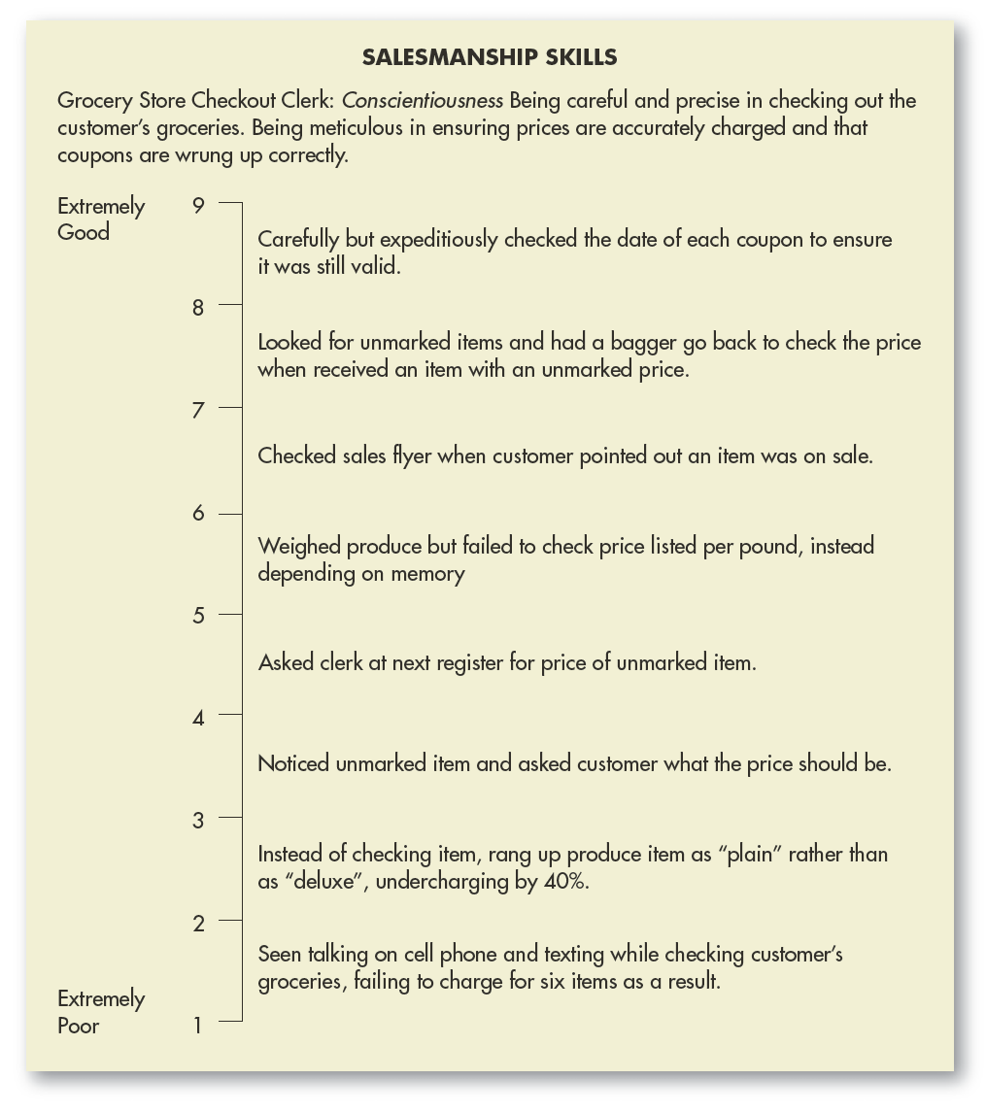
FIGURE 9–8
Example of a Behaviorally
Anchored Rating Scale for the Dimension
Salesmanship Skills
Copyright © 2011 Pearson Education, Inc. publishing as Prentice Hall
9–<number>
Notes:
Human Resources Management 12e
Gary Dessler
Copyright © 2011 Pearson Education, Inc. publishing as Prentice Hall
9–<number>
Figure 9-8 presents an example of a section of a final BARS instrument that lists the critical incidents that serve as behavioral anchors on the performance scale for the dimension Salesmanship Skills.

Slide 23
Management by Objectives (MBO)
A comprehensive and formal organizationwide goal-setting and appraisal program requiring:
  Setting of organization’s goals
  Setting of departmental goals
  Discussion of departmental goals
  Defining expected results (setting individual goals)
  Conducting periodic performance reviews
  Providing performance feedback
Copyright © 2011 Pearson Education, Inc. publishing as Prentice Hall
9–<number>
Notes:
Human Resources Management 12e
Gary Dessler
Copyright © 2011 Pearson Education, Inc. publishing as Prentice Hall
9–<number>
Employers use management by objectives (MBO) for one of two things. Many use it as the primary appraisal method. Others use it to supplement to a graphic rating or other appraisal method. MBO generally refers to the comprehensive and formal organizationwide goal-setting and appraisal program.

Slide 24
Using MBO
Potential Problems with MBO
Setting unclear objective
Time-consuming appraisal process
Conflict with subordinates over objectives
Copyright © 2011 Pearson Education, Inc. publishing as Prentice Hall
9–<number>
Notes:
Human Resources Management 12e
Gary Dessler
Copyright © 2011 Pearson Education, Inc. publishing as Prentice Hall
9–<number>
In using MBO, it is best to keep the guidelines for goal setting (SMART, specific, and so on) in mind. Setting objectives with the subordinate sometimes turns into a tug-of-war, with the supervisor pushing for higher quotas and the subordinate pushing for lower ones.
The more that is known about the job and the person’s ability, the more confident a supervisor can be about setting standards.

Slide 25
Computerized and Web-Based
Performance Appraisal Systems
Allow managers to keep notes on subordinates.
Notes can be merged with employee ratings.
Software generates written text to support appraisals.
Allows for employee self-monitoring and self-evaluation.
Electronic Performance Monitoring (EPM) Systems
  Use computer network technology to allow managers access to their employees’ computers and telephones.
  Managers can monitor the employees’ rate, accuracy, and time spent working online.
Copyright © 2011 Pearson Education, Inc. publishing as Prentice Hall
9–<number>
Notes:
Human Resources Management 12e
Gary Dessler
Copyright © 2011 Pearson Education, Inc. publishing as Prentice Hall
9–<number>
Employers increasingly use computerized or Web-based performance appraisal systems that enable them to keep computerized notes on subordinates during the year. The notes can then be merged with ratings of employees on several performance traits. The software then generates written text to support each part of the appraisal. Most appraisal software combines several of the basic methods such as graphic ratings plus critical incidents or BARS.
Electronic performance monitoring (EPM) systems use computer network technology to allow managers access to their employees’ computers and telephones. They allow managers to monitor the employees’ rate, accuracy, and time spent working online.

Slide 26
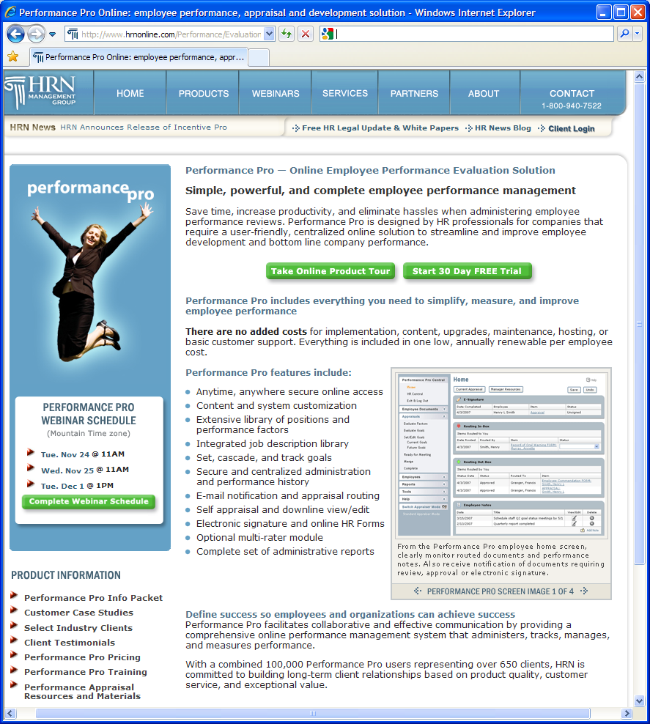
FIGURE 9–9
Online Performance
Appraisal Tool
Copyright © 2011 Pearson Education, Inc. publishing as Prentice Hall
9–<number>
Notes:
Human Resources Management 12e
Gary Dessler
Copyright © 2011 Pearson Education, Inc. publishing as Prentice Hall
9–<number>
Many employers today make use of online appraisals for evaluating employee performance. Figure 9-9 shows an online service’s offerings of a graphic rating scale that is supported with specific behavioral competency expectations. These expectations pinpoint what raters should look for.

Slide 27
Dealing with Performance Appraisal Problems
Potential Rating Scale Appraisal Problems
Unclear standards
Halo
effect
Central tendency
Leniency or strictness
Bias
Copyright © 2011 Pearson Education, Inc. publishing as Prentice Hall
9–<number>
Notes:
Human Resources Management 12e
Gary Dessler
Copyright © 2011 Pearson Education, Inc. publishing as Prentice Hall
9–<number>
Graphic-type rating scales in particular are susceptible to several problems: unclear standards, halo effect, central tendency, leniency or strictness, and bias.

Slide 28
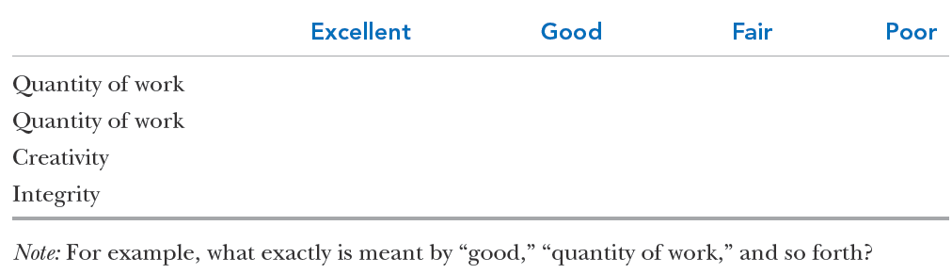
TABLE 9–2 A Graphic Rating Scale with Unclear Standards
Copyright © 2011 Pearson Education, Inc. publishing as Prentice Hall
9–<number>
Notes:
Human Resources Management 12e
Gary Dessler
Copyright © 2011 Pearson Education, Inc. publishing as Prentice Hall
9–<number>
Table 9-2 illustrates the unclear standards problem. This graphic rating scale seems objective. However, it would probably result in unfair appraisals, because the traits and degrees of merit are ambiguous.
The best way to fix this problem is to include descriptive phrases that define or illustrate each trait.

Slide 29
Guidelines for Effective Appraisals
How to Avoid
Appraisal Problems
Know the problems
Use the
right tool
Keep a
diary
Get agreement on a plan
Be
fair
Copyright © 2011 Pearson Education, Inc. publishing as Prentice Hall
9–<number>
Notes:
Human Resources Management 12e
Gary Dessler
Copyright © 2011 Pearson Education, Inc. publishing as Prentice Hall
9–<number>
Managers can do these five things to help ensure that they fairly conduct effective appraisals.

Slide 30
TABLE 9–3 Important Advantages and Disadvantages of Appraisal Tools
Tool | Advantages | Disadvantages
Graphic rating scale | Simple to use; provides a quantitative rating for each employee. | Standards may be unclear; halo effect, central tendency, leniency, bias can also be problems.
BARS | Provides behavioral “anchors.” BARS is very accurate. | Difficult to develop.
Alternation ranking | Simple to use (but not as simple as graphic rating scales). Avoids central tendency and other problems of rating scales. | Can cause disagreements among employees and may be unfair if all employees are, in fact, excellent.
Forced distribution method | End up with a predetermined number or % of people in each group. | Employees’ appraisal results depend on your choice of cutoff points.
Critical incident method | Helps specify what is “right” and “wrong” about the employee’s performance; forces supervisor to evaluate subordinates on an ongoing basis. | Difficult to rate or rank employees relative to one another.
MBO | Tied to jointly agreed-upon performance objectives. | Time-consuming.
Copyright © 2011 Pearson Education, Inc. publishing as Prentice Hall
9–<number>
Notes:
Human Resources Management 12e
Gary Dessler
Copyright © 2011 Pearson Education, Inc. publishing as Prentice Hall
9–<number>
Use the right appraisal tool—or combination of tools. Each has its own pros and cons. For example, the ranking method avoids central tendency but can cause bad feelings when employees’ performances are in fact all “high.” Table 9-3 summarizes each tool’s pros and cons.

Slide 31
Choosing the Right Appraisal Tool
Criteria for Choosing an Appraisal Tool
Accessibility
Ease-of-use
Employee acceptance
Accuracy
Copyright © 2011 Pearson Education, Inc. publishing as Prentice Hall
9–<number>
Notes:
Human Resources Management 12e
Gary Dessler
Copyright © 2011 Pearson Education, Inc. publishing as Prentice Hall
9–<number>
In practice, employers choose an appraisal tool based on several criteria. Accessibility and ease-of-use are probably first. Employers (and supervisors) prefer to avoid the push-back from employees who resist certain appraisal methods. For other employers, accuracy is a great concern.

Slide 32
FIGURE 9–10 Selected Best Practices for Administering Fair Performance Appraisals
Base the performance review on duties and standards from a job analysis.
Try to base the performance review on observable job behaviors or objective performance data.
Make it clear ahead of time what your performance expectations are.
Use a standardized performance review procedure for all employees.
Make sure whoever conducts the reviews has frequent opportunities to observe the employee’s job performance.
Either use multiple raters or have the rater’s supervisor evaluate the appraisal results.
Include an appeals mechanism.
Document the appraisal review process and results.
Discuss the appraisal results with the employee.
Let the employees know ahead of time how you’re going to conduct the review and use the results.
Let the employee provide input regarding your assessment of him or her.
Indicate what the employee needs to do to improve.
Thoroughly train the supervisors who will be doing the appraisals.
Copyright © 2011 Pearson Education, Inc. publishing as Prentice Hall
9–<number>
Notes:
Human Resources Management 12e
Gary Dessler
Copyright © 2011 Pearson Education, Inc. publishing as Prentice Hall
9–<number>
One study found that a number of best practices, such as “have an appeal mechanism,” distinguish fair appraisals. Figure 9-10 summarizes these.

Slide 33
FIGURE 9–11 Guidelines for a Legally Defensible Appraisal
Preferably, conduct a job analysis to establish performance criteria and standards.
Communicate performance standards to employees and to those rating them, in writing.
When using graphic rating scales, avoid undefined abstract trait names (such as “loyalty” or “honesty”).
Use subjective narratives as only one component of the appraisal.
Train supervisors to use the rating instrument properly.
Allow appraisers substantial daily contact with the employees they’re evaluating.
Using a single overall rating of performance is usually not acceptable to the courts.
When possible, have more than one appraiser, and conduct all such appraisals independently.
One appraiser should never have absolute authority to determine a personnel action.
Give employees the opportunity to review and make comments, and have a formal appeals process.
Document everything: Without exception, courts condemn informal performance evaluation practices that eschew documentation.
Where appropriate, provide corrective guidance to assist poor performers in improving.
Copyright © 2011 Pearson Education, Inc. publishing as Prentice Hall
9–<number>
Notes:
Human Resources Management 12e
Gary Dessler
Copyright © 2011 Pearson Education, Inc. publishing as Prentice Hall
9–<number>
Figure 9-11 lists guidelines for developing a legally defensible appraisal process.

Slide 34
Who Should Do the Appraising?
Immediate supervisor
Self-rating
Potential Appraisers
Peers
Subordinates
Rating
committee
360-degree feedback
Copyright © 2011 Pearson Education, Inc. publishing as Prentice Hall
9–<number>
Notes:
Human Resources Management 12e
Gary Dessler
Copyright © 2011 Pearson Education, Inc. publishing as Prentice Hall
9–<number>
Traditionally, the employee’s direct supervisor appraises his or her performance. However, other options are available and used.

Slide 35
The Appraisal Interview
Satisfactory—Promotable
Satisfactory—Not Promotable
Types of Appraisal Interviews
Unsatisfactory—Correctable
Unsatisfactory—Uncorrectable
Copyright © 2011 Pearson Education, Inc. publishing as Prentice Hall
9–<number>
Notes:
Human Resources Management 12e
Gary Dessler
Copyright © 2011 Pearson Education, Inc. publishing as Prentice Hall
9–<number>
As a supervisor, you will face four types of appraisal interviews, each with its unique objectives.

Slide 36
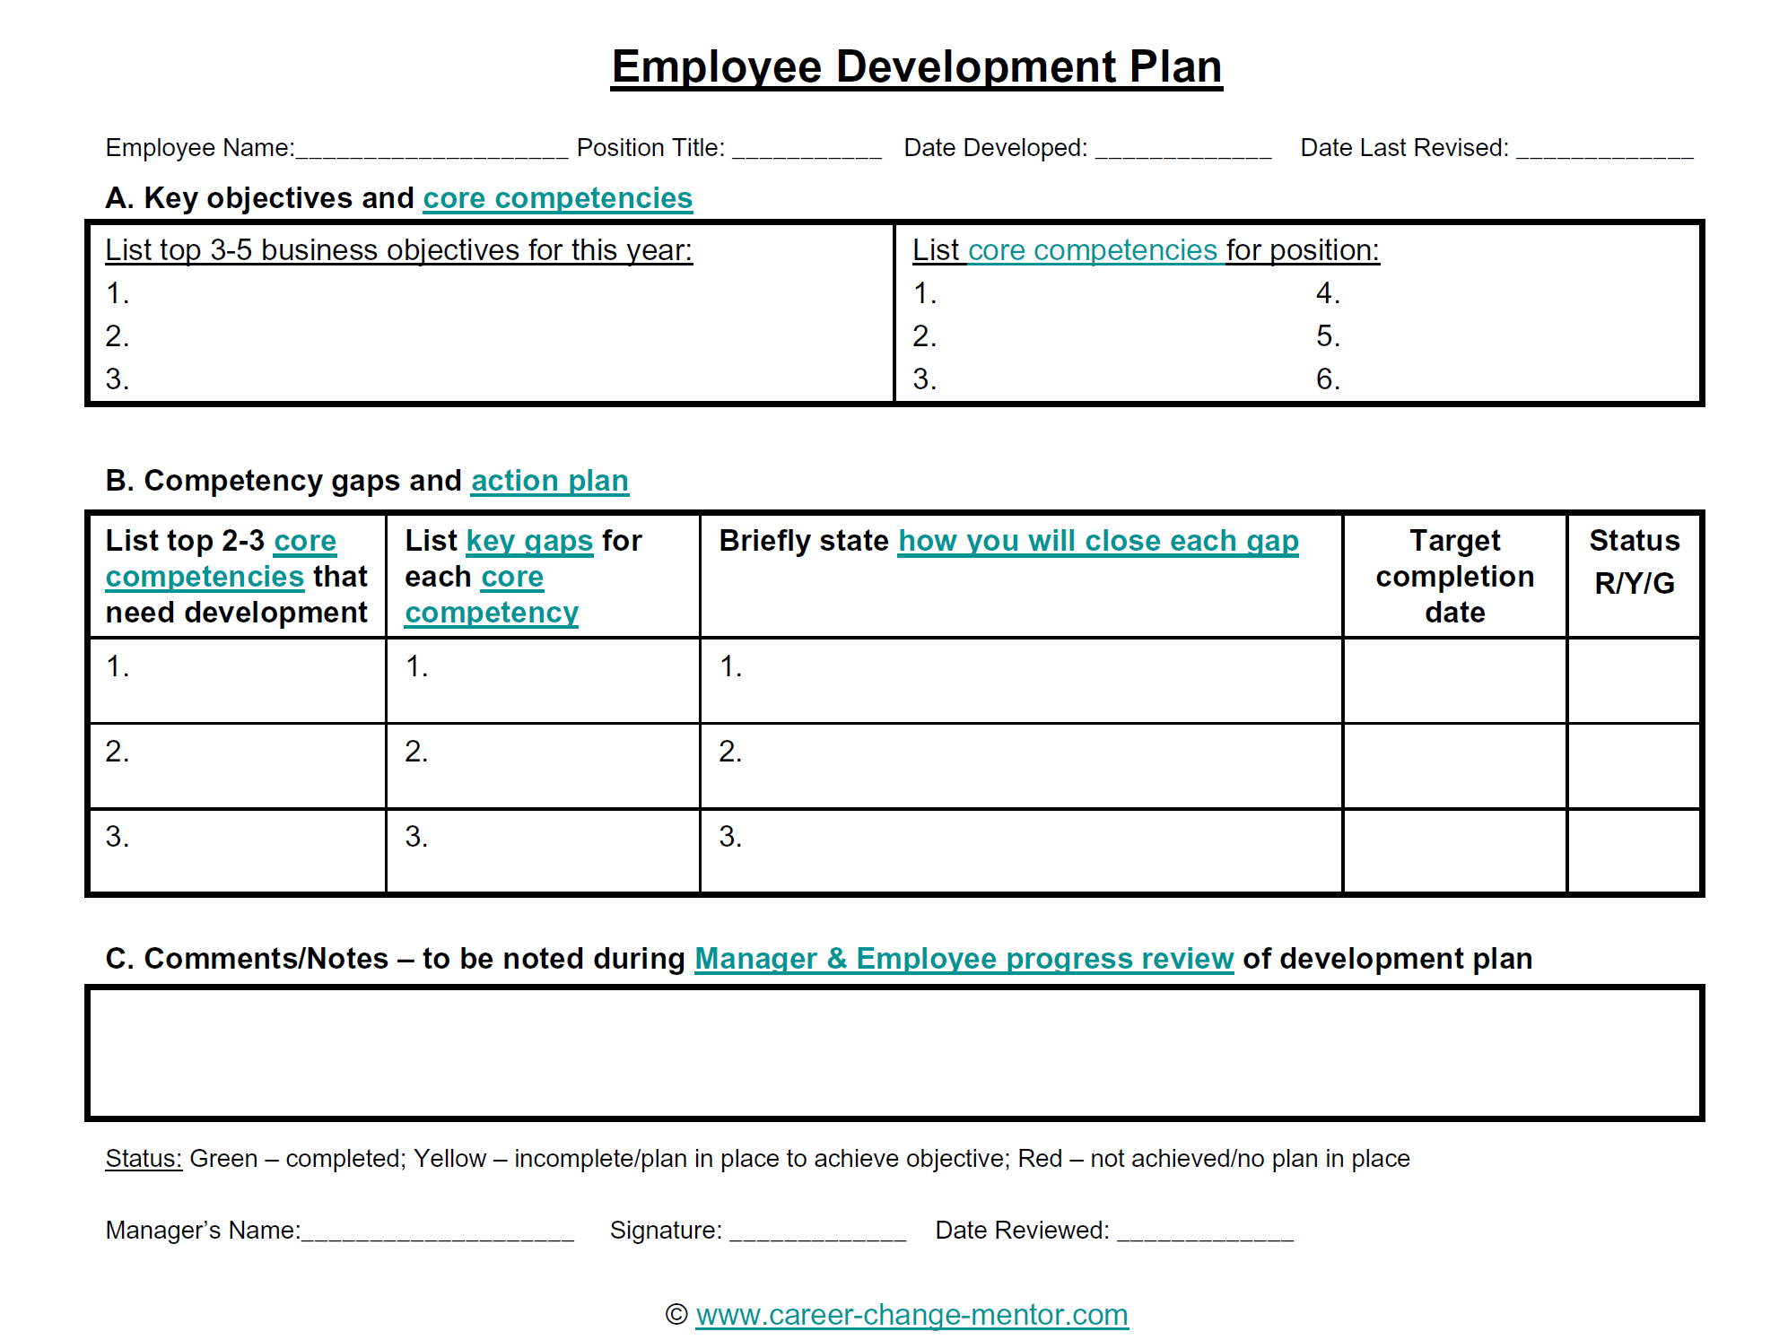
FIGURE 9–12 Sample Employee Development Plan
Copyright © 2011 Pearson Education, Inc. publishing as Prentice Hall
9–<number>
Notes:
Human Resources Management 12e
Gary Dessler
Copyright © 2011 Pearson Education, Inc. publishing as Prentice Hall
9–<number>
Figure 9-12 presents a form that can be used when the person’s performance is unsatisfactory but correctable and the interview objective is to lay out an action plan for correcting the unsatisfactory performance.

Slide 37
Appraisal Interview Guidelines
Guidelines for Conducting
an Interview
Talk in terms of objective work data
Don’t get personal
Encourage the person to talk
Get
agreement
Copyright © 2011 Pearson Education, Inc. publishing as Prentice Hall
9–<number>
Notes:
Human Resources Management 12e
Gary Dessler
Copyright © 2011 Pearson Education, Inc. publishing as Prentice Hall
9–<number>
These are four main things to keep mind when actually conducting the interview.

Slide 38
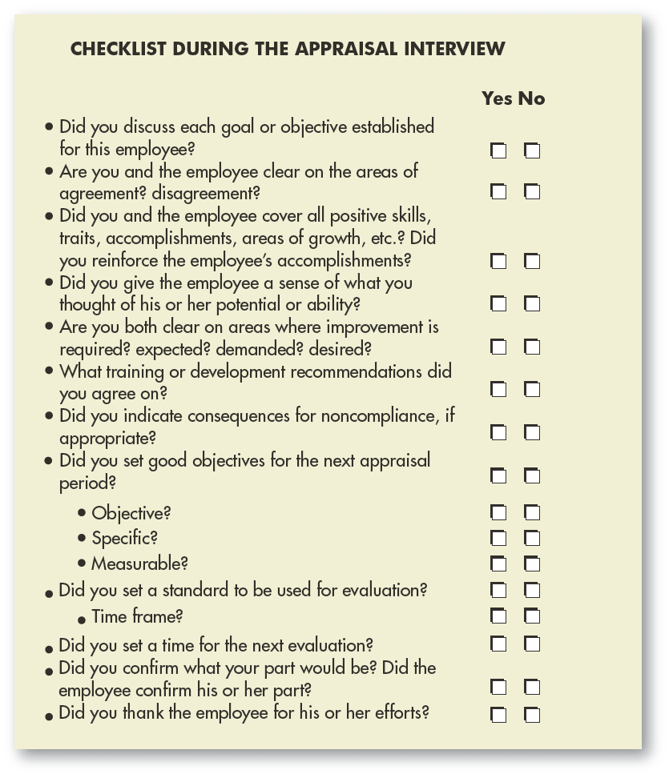
FIGURE 9–13
Checklist During
Appraisal Interview
Copyright © 2011 Pearson Education, Inc. publishing as Prentice Hall
9–<number>
Notes:
Human Resources Management 12e
Gary Dessler
Copyright © 2011 Pearson Education, Inc. publishing as Prentice Hall
9–<number>
Figure 9-13 provides a checklist to help managers cover all the appraisal interview bases.

Slide 39
Handling Defensive Responses
How to Handle a Defensive Subordinate
1
Recognize that defensive behavior is normal.
2
Never attack a person’s defenses.
3
Postpone action.
4
Recognize your own limitations.
Copyright © 2011 Pearson Education, Inc. publishing as Prentice Hall
9–<number>
Notes:
Human Resources Management 12e
Gary Dessler
Copyright © 2011 Pearson Education, Inc. publishing as Prentice Hall
9–<number>
Defenses are a familiar aspect of our lives. When a supervisor tells someone his or her performance is poor, the first reaction is often denial. Denial is a defense mechanism. By denying the fault, the person avoids having to question his or her own competence. Others react with anger and aggression. This helps them let off steam and postpones confronting the immediate problem.

Slide 40
How to Deliver Criticism
How to Criticize a Subordinate
1
Do it in a manner that lets the person maintain his or her dignity and sense of worth.
2
Criticize in private, and do it constructively.
3
Give daily feedback so that the review has no surprises.
4
Never say the person is “always” wrong.
5
Criticism should be objective and free of biases.
Copyright © 2011 Pearson Education, Inc. publishing as Prentice Hall
9–<number>
Notes:
Human Resources Management 12e
Gary Dessler
Copyright © 2011 Pearson Education, Inc. publishing as Prentice Hall
9–<number>
When you must criticize, do so in a manner that lets the person maintain his or her dignity—in private, and constructively.

Slide 41
Formal Written Warnings
Purposes of a Written Warning
  To shake your employee out of bad habits.
  To help you defend your rating, both to your own boss and (if needed) to the courts.
A Written Warning Should:
  Identify standards by which employee is judged.
  Make clear that employee was aware of the standard.
  Specify deficiencies relative to the standard.
  Indicate employee’s prior opportunity for correction.
Copyright © 2011 Pearson Education, Inc. publishing as Prentice Hall
9–<number>
Notes:
Human Resources Management 12e
Gary Dessler
Copyright © 2011 Pearson Education, Inc. publishing as Prentice Hall
9–<number>
An employee’s performance may be so weak that it requires a formal written warning.

Slide 42
Performance Management
Performance Management
  Is the continuous process of identifying, measuring, and developing the performance of individuals and teams and aligning their performance with the organization’s goals.
How Performance Management Differs From Performance Appraisal
  A continuous process for continuous improvement
  A strong linkage of individual and team goals to strategic goals
  A constant reevaluation and modification of work processes
Copyright © 2011 Pearson Education, Inc. publishing as Prentice Hall
9–<number>
Notes:
Human Resources Management 12e
Gary Dessler
Copyright © 2011 Pearson Education, Inc. publishing as Prentice Hall
9–<number>
Performance management is the continuous process of identifying, measuring, and developing the performance of individuals and teams and aligning their performance with the organization’s goals.

Slide 43
Basic Building Blocks of
Performance Management
Direction sharing
Goal
alignment
Ongoing performance monitoring
Ongoing
feedback
Coaching and development support
Rewards, recognition, and compensation
Copyright © 2011 Pearson Education, Inc. publishing as Prentice Hall
9–<number>
Notes:
Human Resources Management 12e
Gary Dessler
Copyright © 2011 Pearson Education, Inc. publishing as Prentice Hall
9–<number>
Performance management’s basic building blocks or “DNA” are:
Direction sharing means communicating the company’s higher-level goals (including its vision, mission, and strategy) throughout the company and then translating these into doable departmental, team, and individual goals.
Goal alignment means having a process that enables any manager to see the link between an employee’s goals and those of his or her department and company.
Ongoing performance monitoring usually includes using computer-based systems that measure and then e-mail progress and exception reports based on the person’s progress toward meeting his or her performance goals.
Ongoing feedback includes both face-to-face and computer-based feedback regarding progress toward goals.
Coaching and developmental support should be an integral part of the feedback process.
Rewards, recognition, and compensation all play a role in providing the consequences needed to keep the employee’s goal-directed performance on track.

Slide 44
Why Performance Management?
Total Quality Management
The Performance Management Approach
Resolution of Appraisal Issues
Strategic Goal Alignment
Copyright © 2011 Pearson Education, Inc. publishing as Prentice Hall
9–<number>
Notes:
Human Resources Management 12e
Gary Dessler
Copyright © 2011 Pearson Education, Inc. publishing as Prentice Hall
9–<number>
Employers are moving to performance management for three main reasons—total quality, appraisal issues, and strategic planning.

Slide 45
Using Information Technology to
Support Performance Management
Assign financial and nonfinancial goals to each team’s activities along the strategy map chain of activities leading up to the company’s overall strategic goals.
Inform all employees of their goals.
Use IT-supported tools like scorecard software and digital dashboards to continuously monitor and assess each team’s and employee’s performance.
Take corrective action at once.
Copyright © 2011 Pearson Education, Inc. publishing as Prentice Hall
9–<number>
Notes:
Human Resources Management 12e
Gary Dessler
Copyright © 2011 Pearson Education, Inc. publishing as Prentice Hall
9–<number>
This slide sums up how IT-supported performance management process supports performance management.

Slide 46
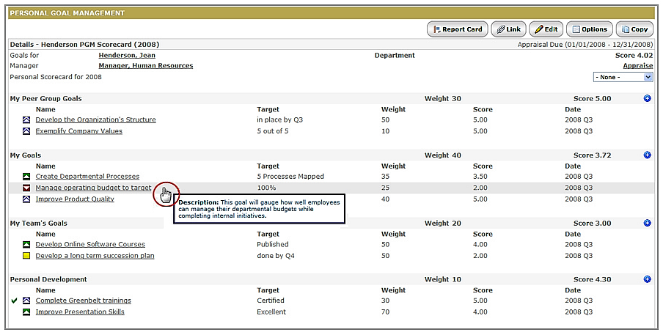
FIGURE 9–14 Performance Management Report
Copyright © 2011 Pearson Education, Inc. publishing as Prentice Hall
9–<number>
Notes:
Human Resources Management 12e
Gary Dessler
Copyright © 2011 Pearson Education, Inc. publishing as Prentice Hall
9–<number>
Information technology does enable management to automate performance management. Figure 9-14 presents an example of an employee’s online performance management report.

Slide 47
K E Y T E R M S
performance appraisal
graphic rating scale
alternation ranking method
paired comparison method
forced distribution method
critical incident method
behaviorally anchored rating scale (BARS)
electronic performance monitoring (EPM)
unclear standards
halo effect
central tendency
strictness/leniency
bias
appraisal interview
performance management
Copyright © 2011 Pearson Education, Inc. publishing as Prentice Hall
9–<number>
Notes:
Human Resources Management 12e
Gary Dessler
Copyright © 2011 Pearson Education, Inc. publishing as Prentice Hall
9–<number>

